Slide 1
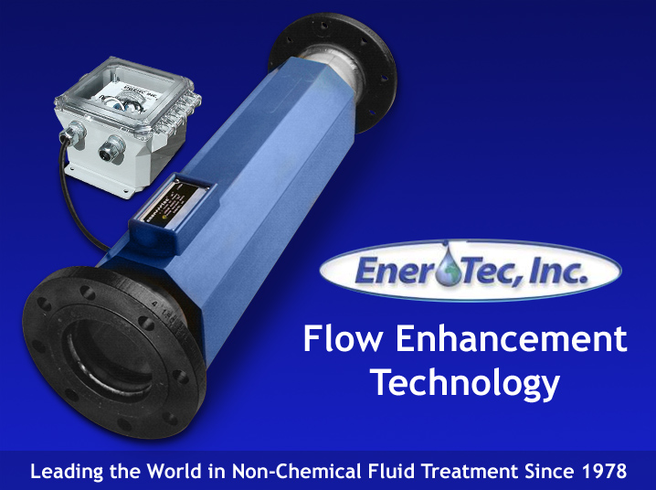

Slide 2
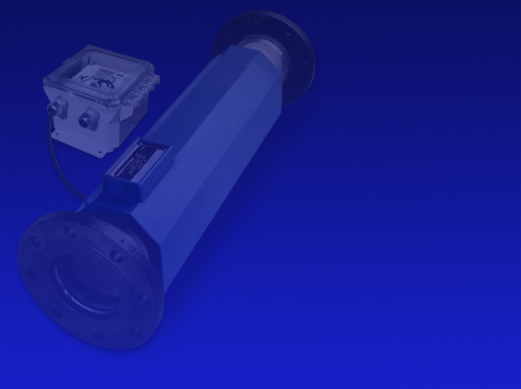
History
Ener-Tec, Inc. was incorporated in 1978 after many successful prototype installations of the LKC on boilers, cooling towers, ice machines, process water, etc.
A vast amount of application data has been accumulated throughout the commercial and industrial markets enabling complete evaluation of each new installation.

Slide 3
Prevent Paraffin and Scale Deposition
Non Chemical
Non Restricted Flow
Low Operating Cost
No Maintenance
Little Space Requirement
Non Polluting
Fast Return On Investment
Prevents And Removes Buildup

Slide 4
Principle of Operation
The Linear Kinetic Cell (LKC) is composed of an induction coil having thousands of feet of insulated copper wire powered by a pulsating DC Electrical current. This pulsating energy forces a majority of the atoms within the fluid to align parallel to one another lowering the energy to a level that crystals cannot form as scale or paraffin deposits.

Slide 5
Return On Investment
The LKC System has a very fast return on investment (R.O.I.) of typically one year or less.
Customers have reported paybacks of under 3 months.

Slide 6
Environmental Impact
The LKC System is a physical method of changing the molecular structure in the liquid (oil, water, etc.) so it has different characteristics. This is no different than changing the characteristics of steel by heat treating or cryogenics. The same molecules are still there, only in a different arrangement or pattern.
In either case nothing was added or taken away.

Slide 7
Required Maintenance
Due to the unique design, the LKC requires no routine maintenance.
There are no components inside the pipe to restrict flow or require cleaning.
We only ask the customer to make visual checks on the power supply amp meter to confirm that there is current going to the cell.
No system maintenance is required.

Slide 8
Installation
Installation of the LKC system is done utilizing standard plumbing and electrical procedures. Heat sinking the copper pipe next to the urethane is required when sweating LKC into system.
Power supply is pre-wired and all the
AC and DC terminals are clearly marked.

Slide 9
Where Is LKC Applied?
The LKC is applied wherever scale or paraffin buildup is a problem. In oil fields the most common applications are the oil wells and pipelines as well as boilers for heating crude oil.

Slide 10
Temperature Rating
The maximum temperature rating for the standard urethane encapsulated system is 200 degrees F. Higher temperature rated units are available for applications when required.
There is no minimum temperature rating
since the cell generates a small amount
of heat within the cell.

Slide 11
Electrical Requirements
The LKC power supply operates on 110 or
220 VAC, 50/60 Hz (specify when ordering).
Ener-Tec, Inc. can design special systems
to operate on other AC And DC voltages
that are available.
The average system operates at 2 to 4 amps.
Due to continuous operation and amperage
draw solar power is normally not feasible.

Slide 12
Where Is LKC Installed?
On oil wells the cell is installed at the well head and it treats the line in both directions, down hole as well as the line to the storage tanks. For pipelines install the LKC at the beginning of the pipeline. Contact Ener-Tec for guidelines to all other installations.

Slide 13
Water Lift/Oil Wells
Many LKC systems have been installed on oil wells, both off shore and on shore where water is pumped down hole to lift the oil. Scaling is always a problem and can be solved by installing the LKC on the discharge side of the pump.
Unlike chemicals, the LKC adds nothing to the oil/water that has to be removed later.

Slide 14
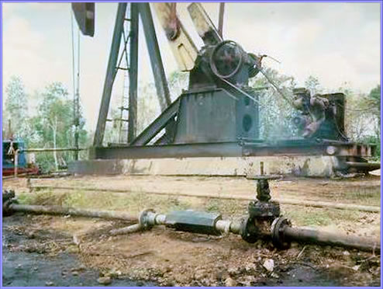
4” LKC IN OIL PIPELINE IN INDONESIA

Slide 15
Oil / Water Separation
The LKC system is being used in oil /water separation eliminating the demulsifier previously used. One customer was spending $5,500.00 a year on demulsifiers before replacing it with the LKC system. They were getting 8% water carry over in the oil before LKC was installed. Now they have a .4% carry over after activating the LKC.
The LKC lowers the energy and surface tension that bonds the water and oil atoms/molecules to each other allowing a more efficient separation.

Slide 16
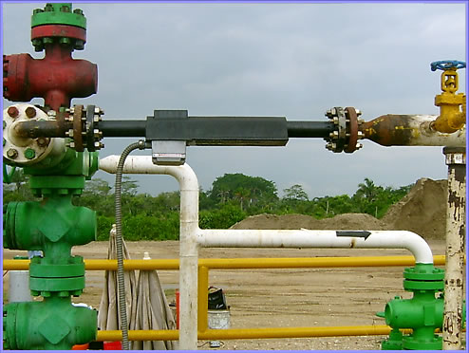
LKC Installation on oil well

Slide 17
Explosion Proof Systems
Explosion proof systems are available in all sizes to meet the Class I, Div. I, Group D codes for installation in hazardous locations.
Most oil well installations have an explosion proof cell but power supply does not have to be since it is installed 50 feet from the well.

Slide 18
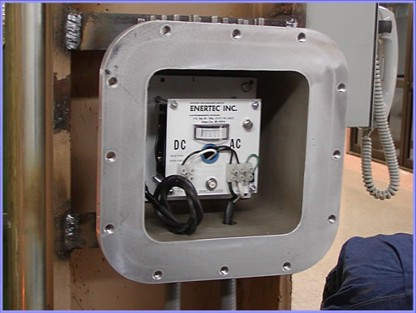
EXPLOSION PROOF POWER SUPPLY WITH COVER REMOVED

Slide 19
Customer Service
If power supply has to be returned for inspection or repair we offer a 24 hour turn around time eliminating the need for the customer to inventory spare parts.
If cell has to be rebuilt it requires two to three weeks.
Returns are very few due to design and construction.
Ener-Tec, Inc. customer service number is
Tele. (517) 741-5015 Fax: (517) 741-3474

Slide 20
Warranty / Guarantee
Ener-Tec, Inc. offers a one year performance guarantee as well as a five year warranty on the total system. Ener-Tec, Inc. has the right to void the warranty and guarantee if the equipment has been tampered with and/or not installed according to the installation instructions shipped with each system.

Slide 21
Customers
In the petroleum industry Ener-Tec, Inc. has a large customer base including most of the major oil well and pipeline companies, both off shore and on shore.
The industrial sector includes nearly all the major corporations including auto manufacturers, food plants, steel mills, foundries, plastics molding, glass companies, paper mills, power plants, etc.

Slide 22
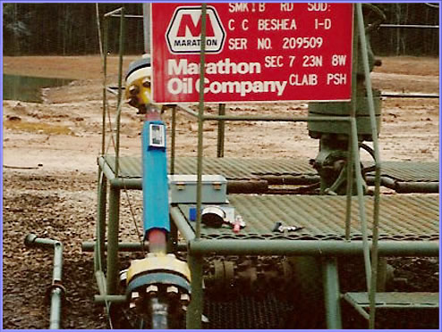
2” LKC ON OIL WELL

Slide 23
Customers
Texaco in Texas, USA
Texaco installed an LKC System on a 174 mile pipeline treating crude oil. All of their paraffin and scale problems were solved.

Slide 24
Customers
Egypt
LKC was installed on an offshore platform which increased production by 24% by eliminating scale and paraffin. Shutdown for cleaning is no longer required.

Slide 25
Customer List - Paraffin Control
B.P. Amoco
Shell Pipeline
Chevron
Trojan Pipeline
Enbridge Pipeline
Diamond Shamrock
Baruch & Foster
Hadson Oil Co.
TMR Exploration
Transpetco
Marathon Oil
Navajo Pipeline
Eott Pipeline
ExxonMobil Pipeline
Four Corners
Pride Pipeline
Equilon Pipeline
Plains All American
Conoco Phillips
Texaco Pipeline
Many others.

Slide 26
Thank You
On behalf of Ener-Tec, Inc. I want to thank each of you for taking time from your busy schedule to view this presentation.
If you have any particular questions please contact us at your convenience.
Larry L. Shroyer, President
Ener-Tec, Inc. USA
Tele :(517 )741 5015
Fax: (517) 741 3474
Email: larry@ener-tec.com

